Slide 1
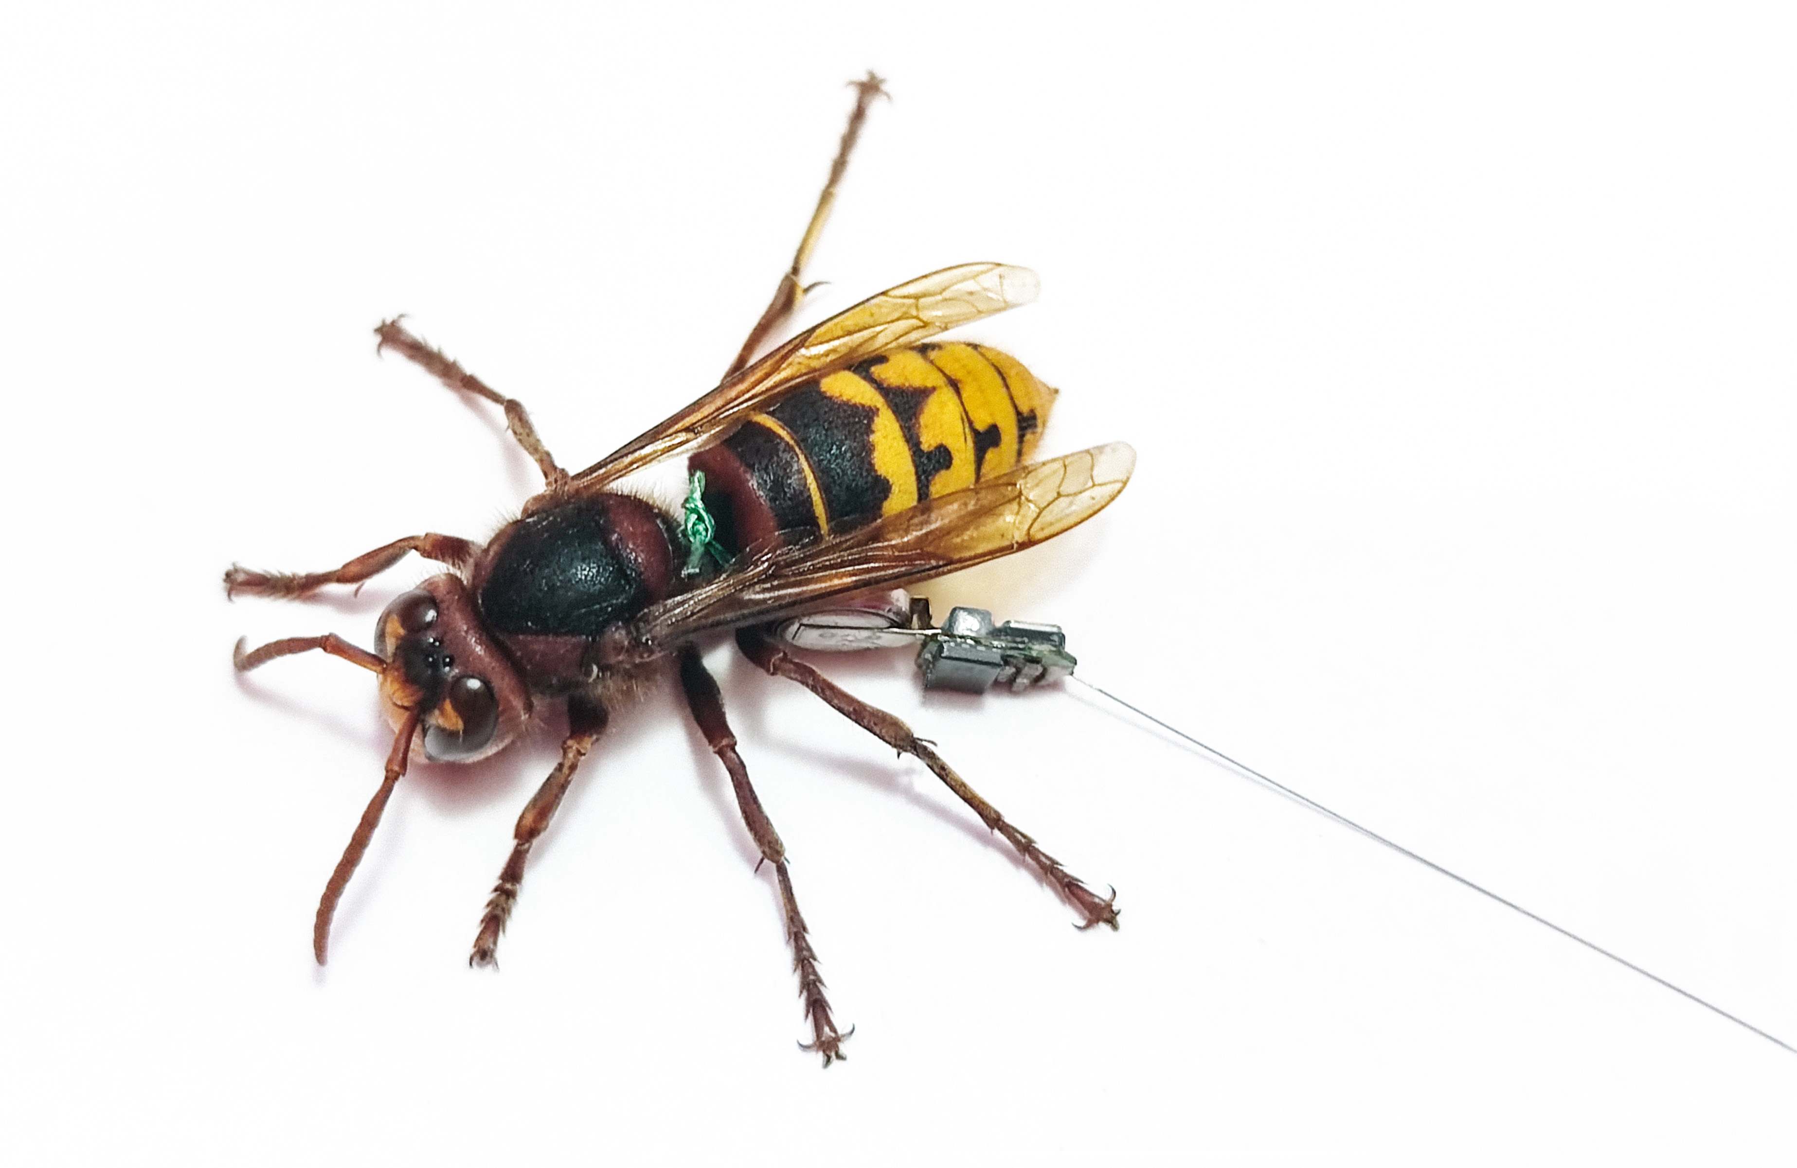
INNOVATIVE RADIO TELEMETRY SOLUTIONS FOR TRACKING ASIAN HORNETS
Richárd Wohlfart Jr.
Richárd Wohlfart
Ákos Miklós Phd.

Slide 2
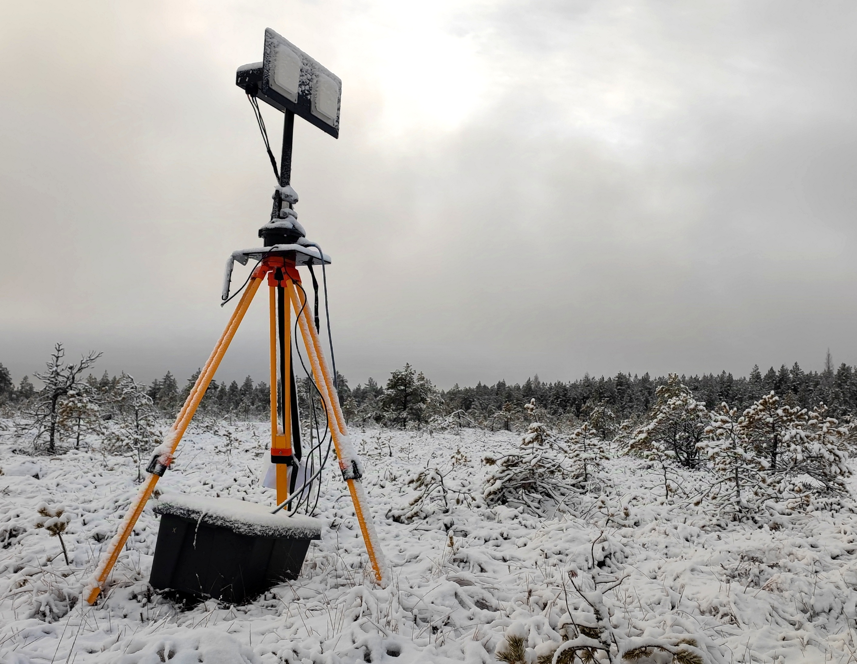
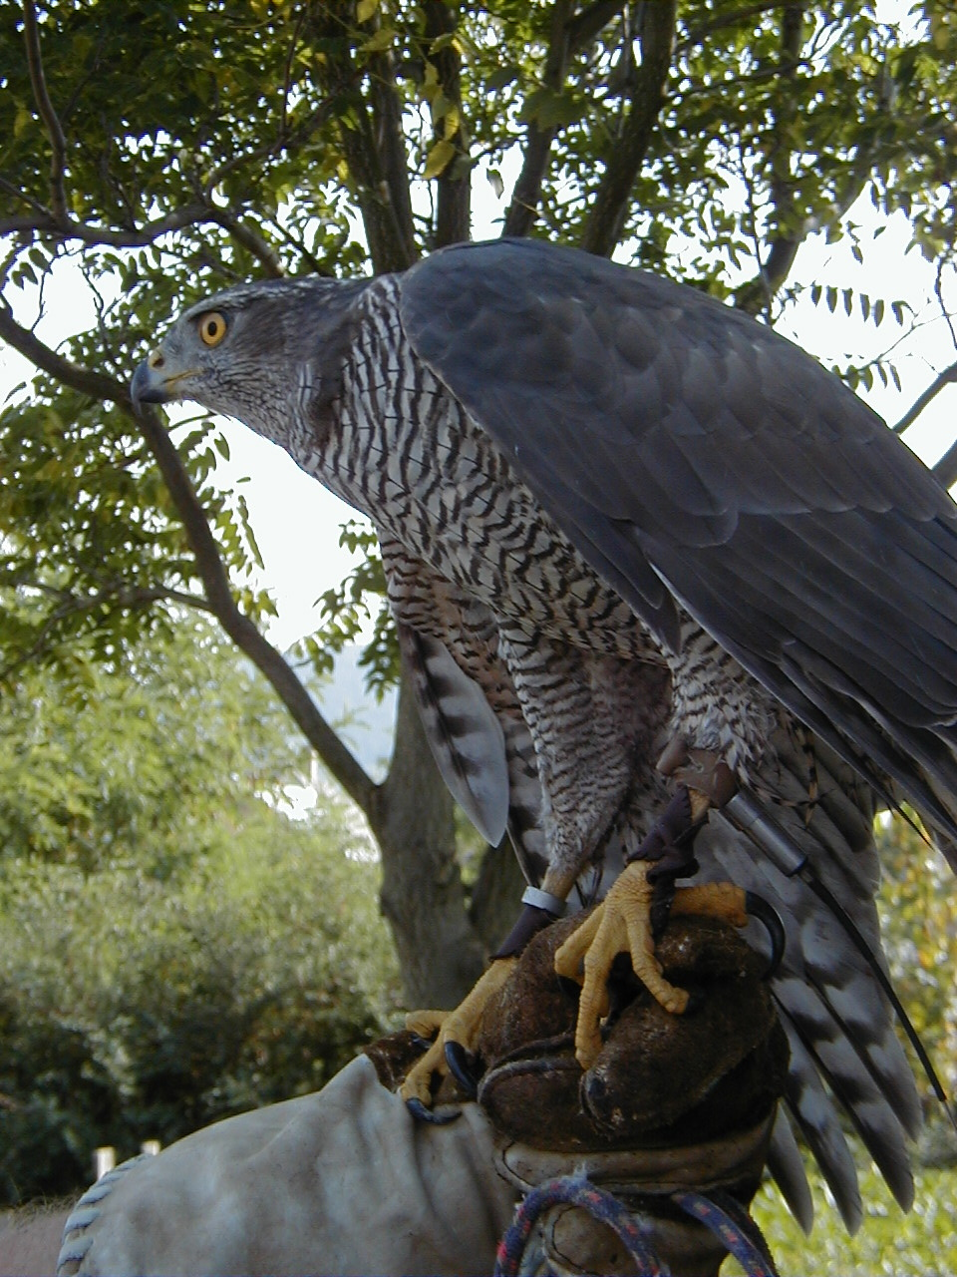
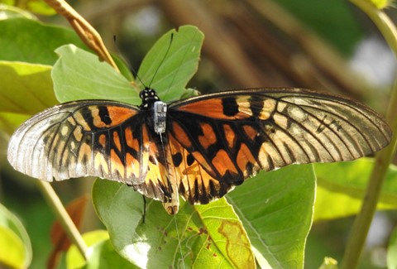
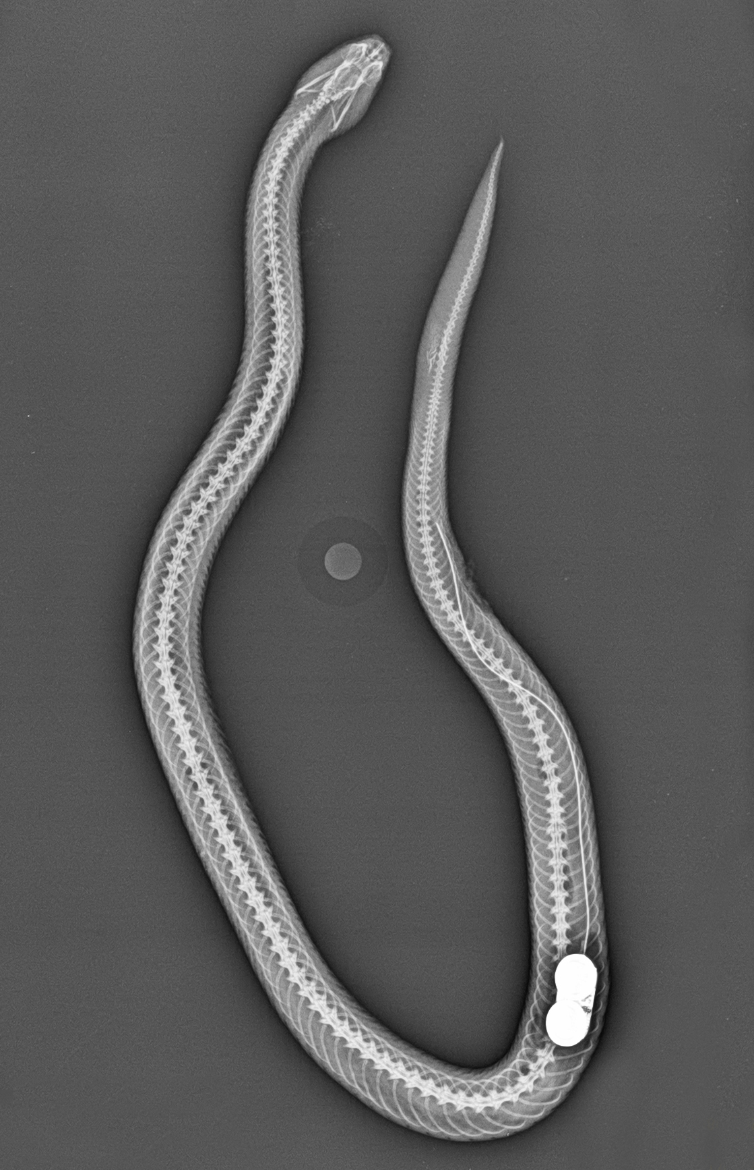
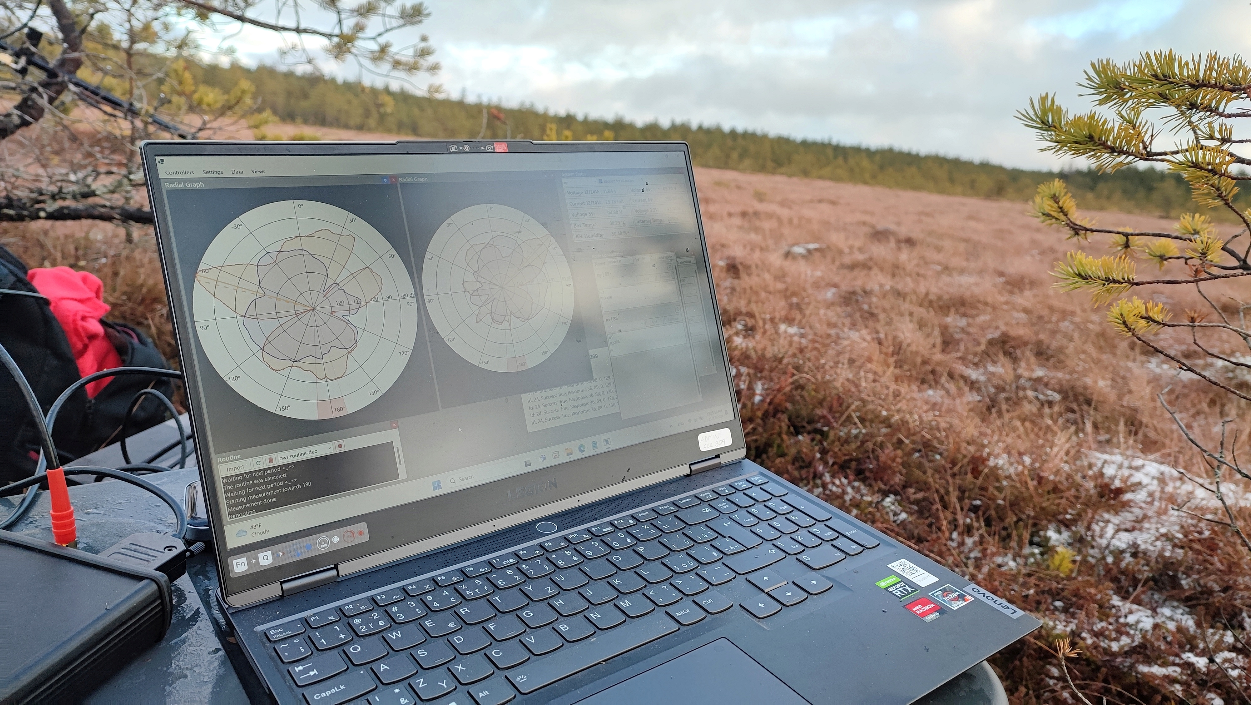
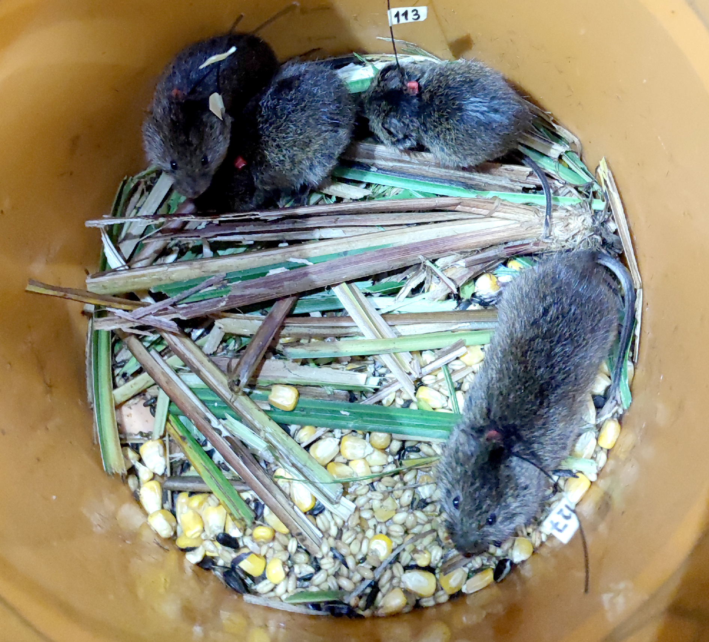
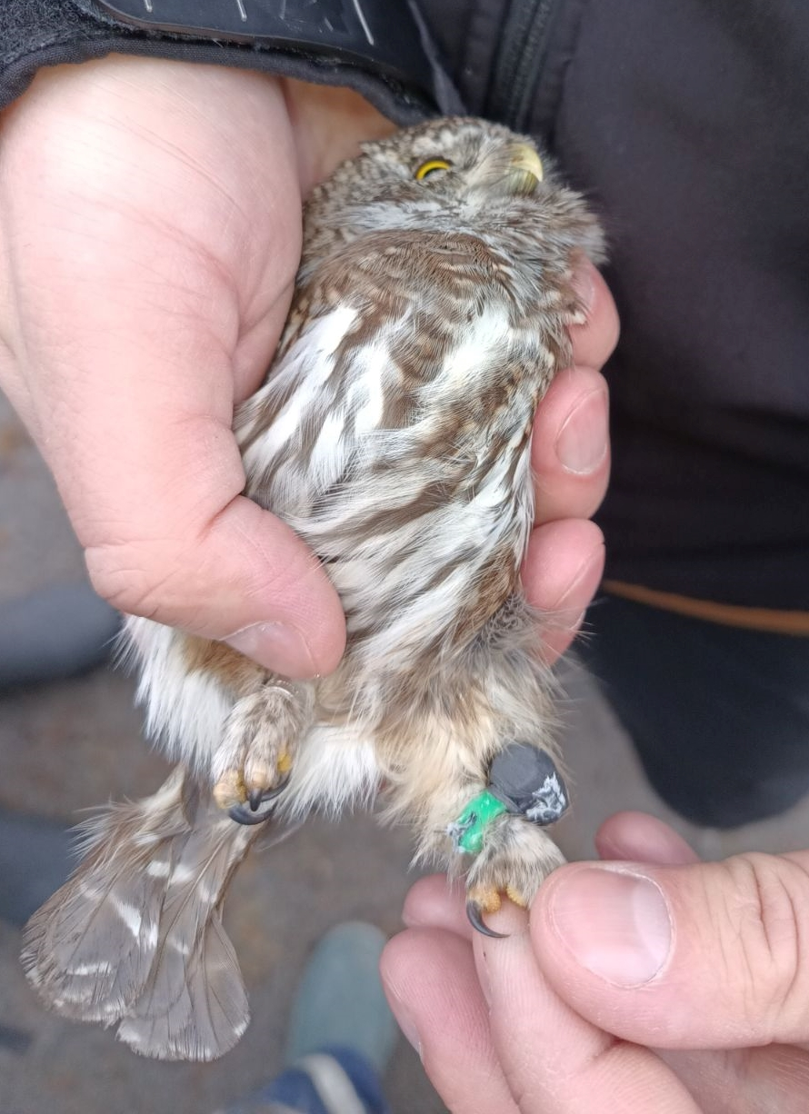
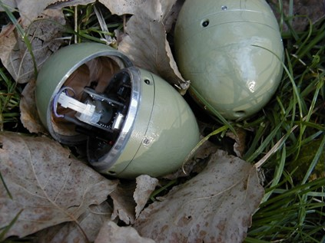
info@telemetry.hu | www.telemetry.hu | Wohlfart Richárd

Slide 3
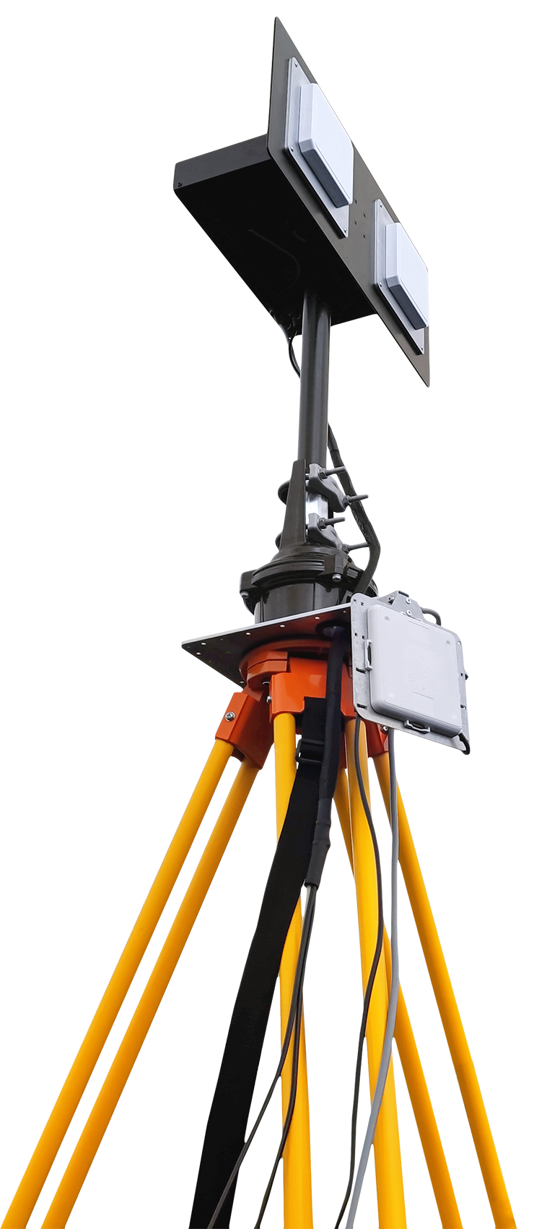
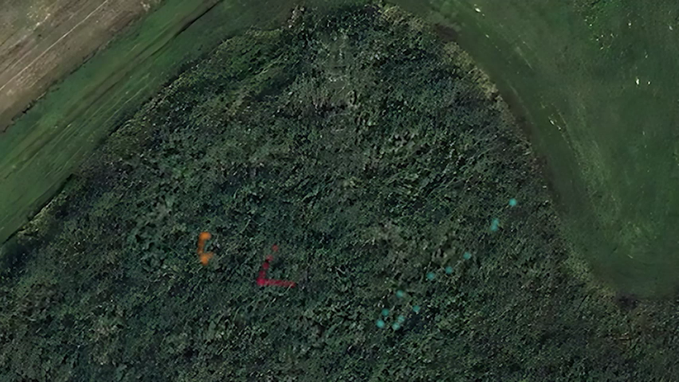
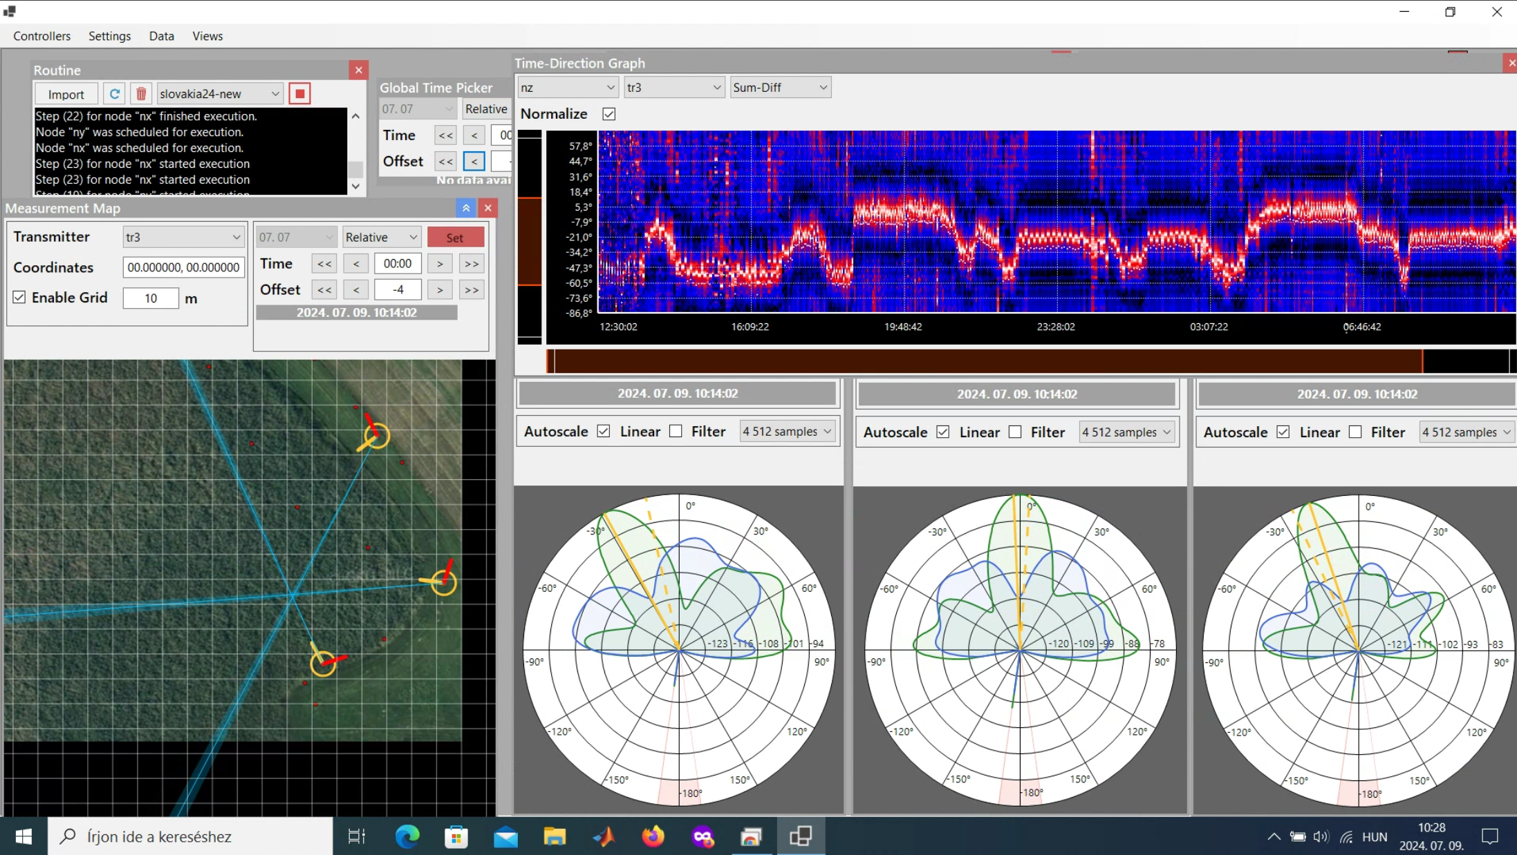
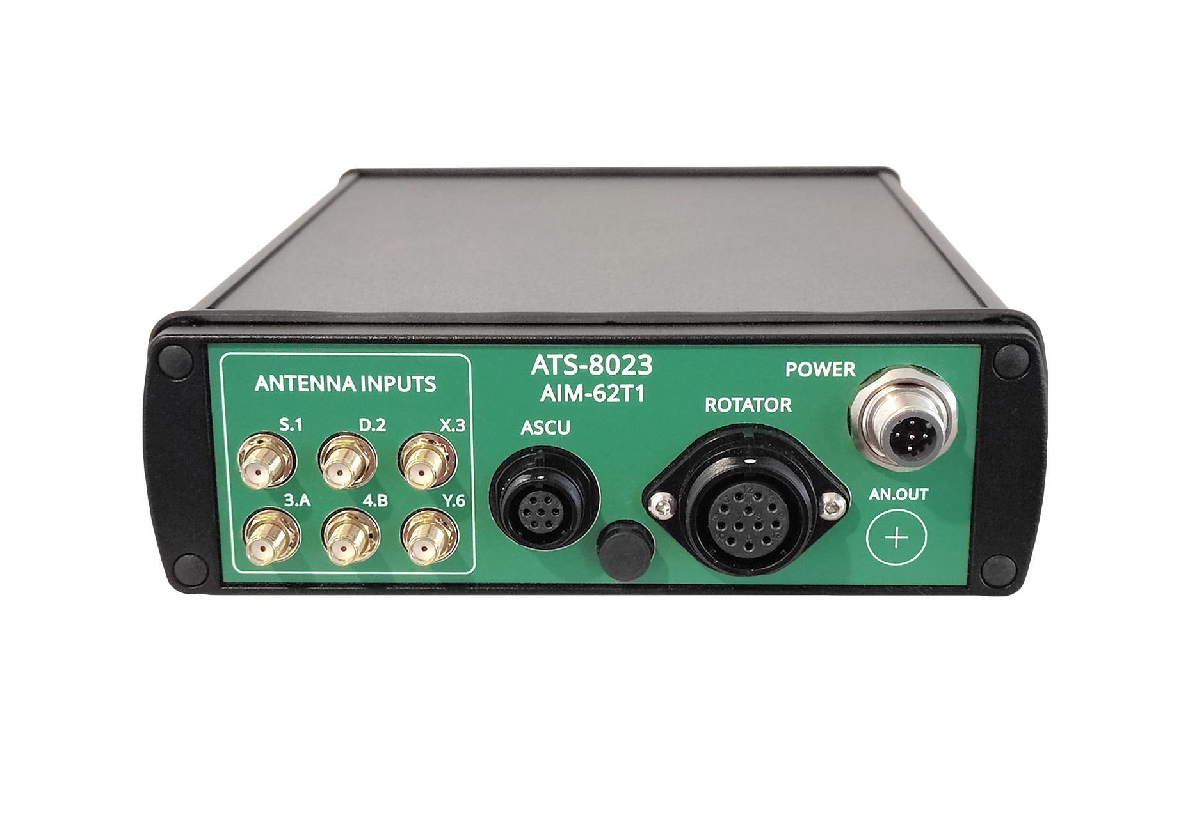
Automated Radio Telemetry System
For small and medium home range animals (1 ha – 100 ha, small mammals, insects, certain bird species, etc.)
Frequent (<= 1 min) and accurate (~1-2 m) position measurements
Portable system, setup is 1-4 hours
info@telemetry.hu | www.telemetry.hu | Richárd Wohlfart

Slide 4

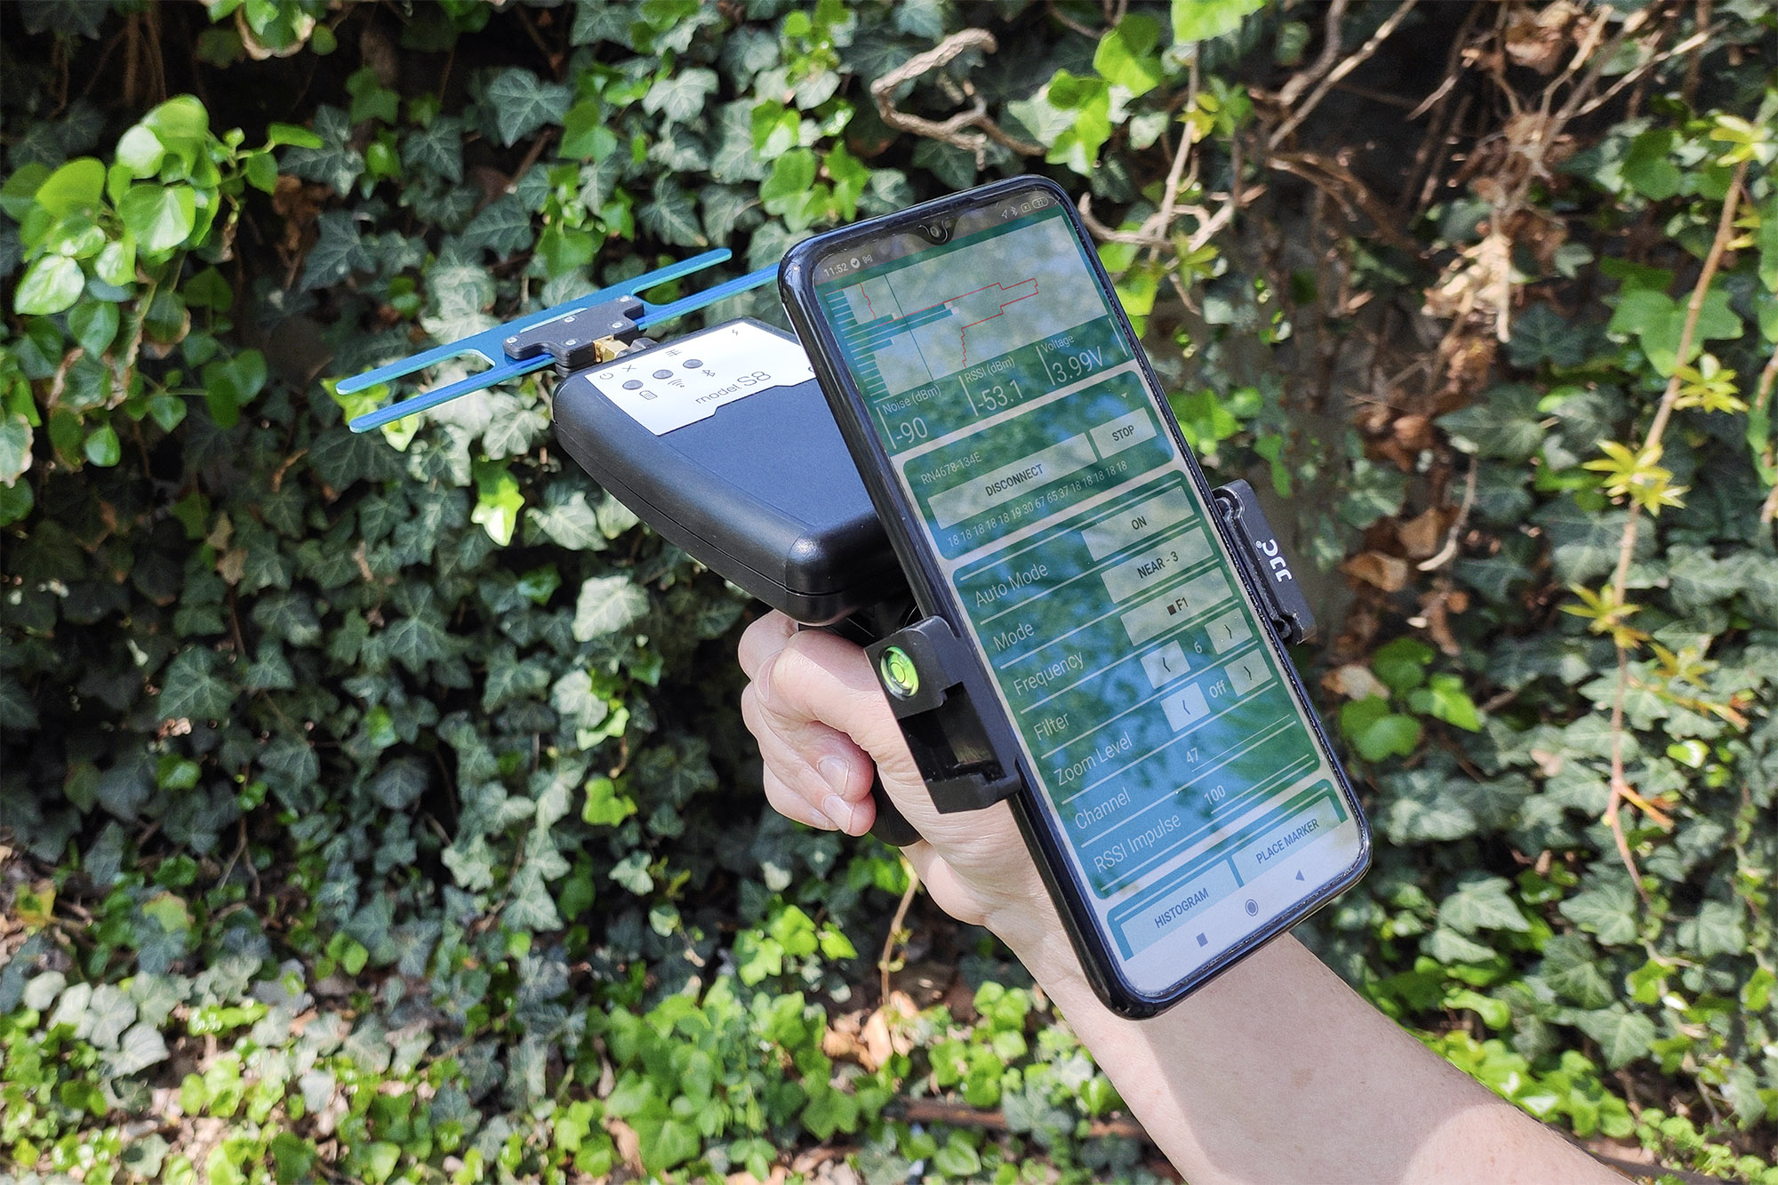
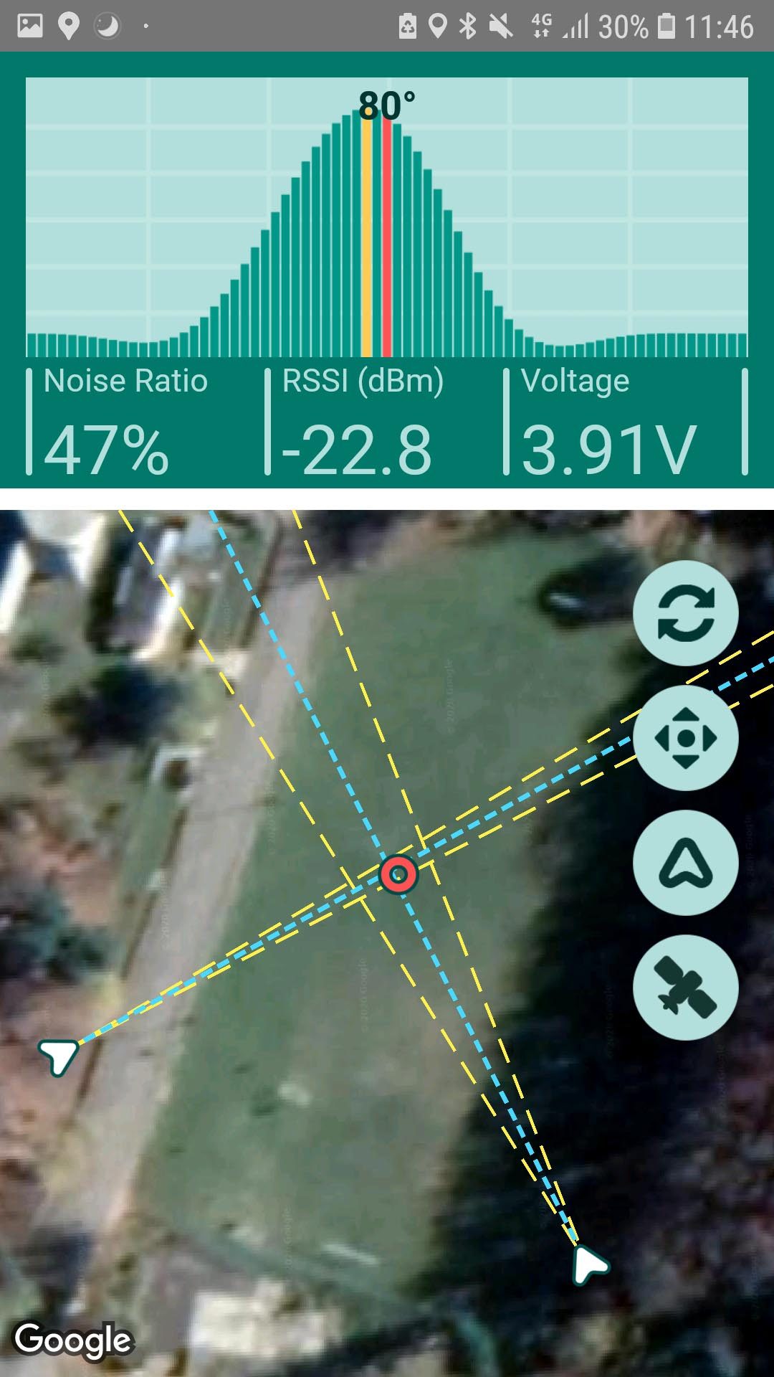
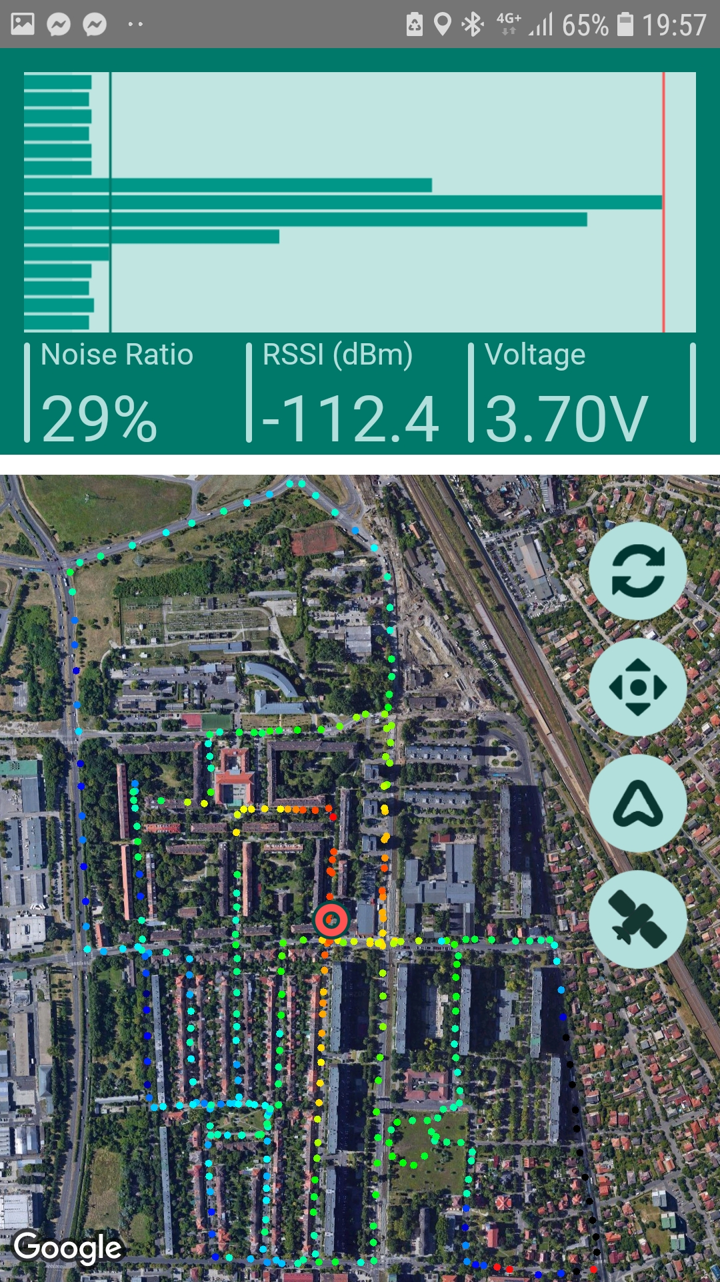
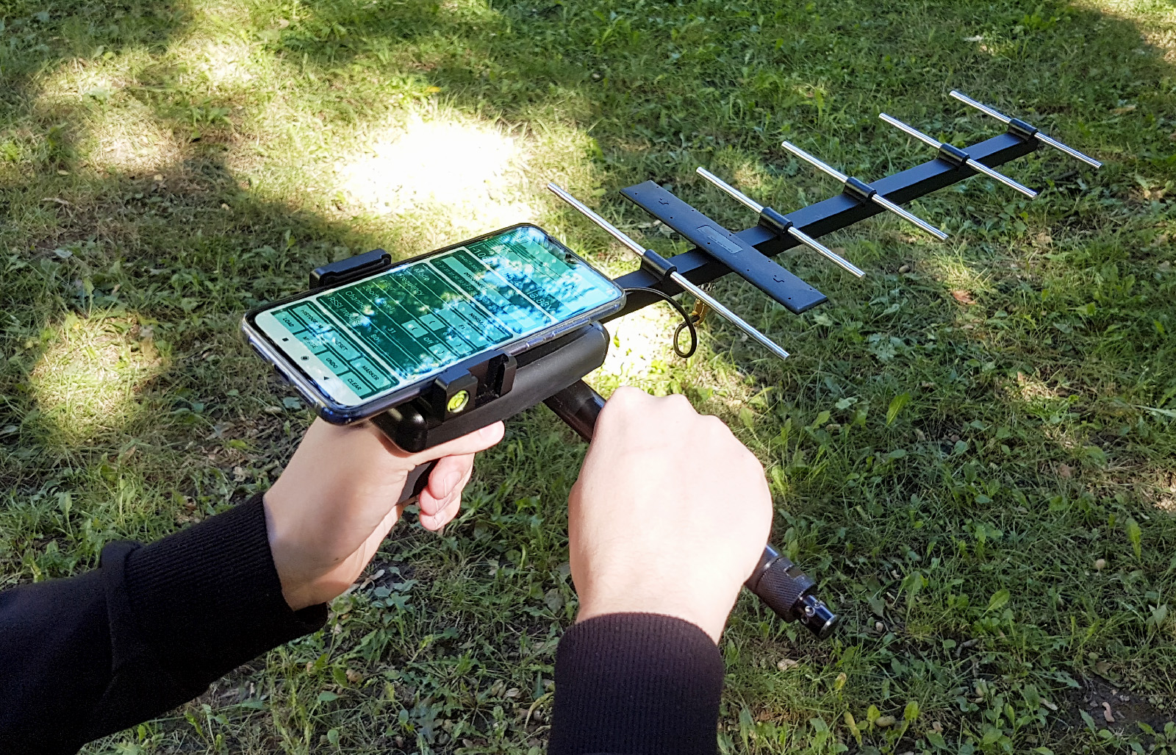
Handheld Receivers
Traditional receiver combined with modern solutions => Smartphone support
Modes of operation: Traditional, Semi-autonomous, heatmap-based
Multiple graph types, integrated map
Logs all signal data into files
Can be used with PC processing software => Simultanious monitoring of up to 30-40 animals
info@telemetry.hu | www.telemetry.hu | Wohlfart Richárd

Slide 5
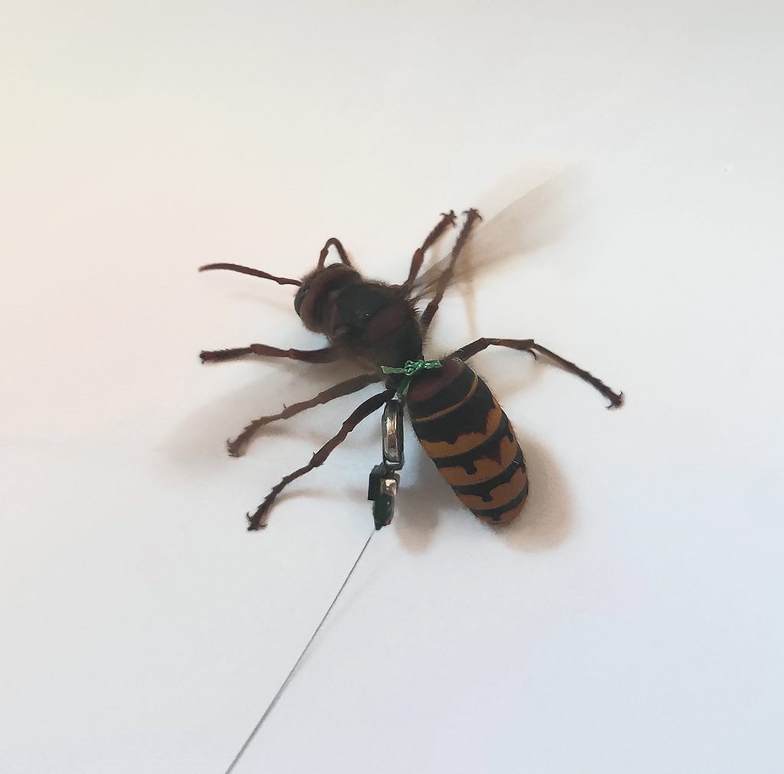
Our Hornet Transmitters
Weighs 140 mg – Among the smallest available
-18.5 dBm Effective Radiated Power – dBm relative, measured with TEM cell
Up to 10 days of operating time – depends on configuration
Schedulable – transmitters can be programmed to only transmitt at certain times of day
LED attachment – visible during night
info@telemetry.hu | www.telemetry.hu | Wohlfart Richárd

Slide 6
Our Hornet Transmitters
Operates in the 434 MHz ISM Band – No permission needed for use
High frequency stability – No need for tuning receiver, (competing devices are unstable)
Rechargeable batteries – we can make charger docks
Can be made to operate on any frequency up to 434 MHz
info@telemetry.hu | www.telemetry.hu | Wohlfart Richárd

Slide 7
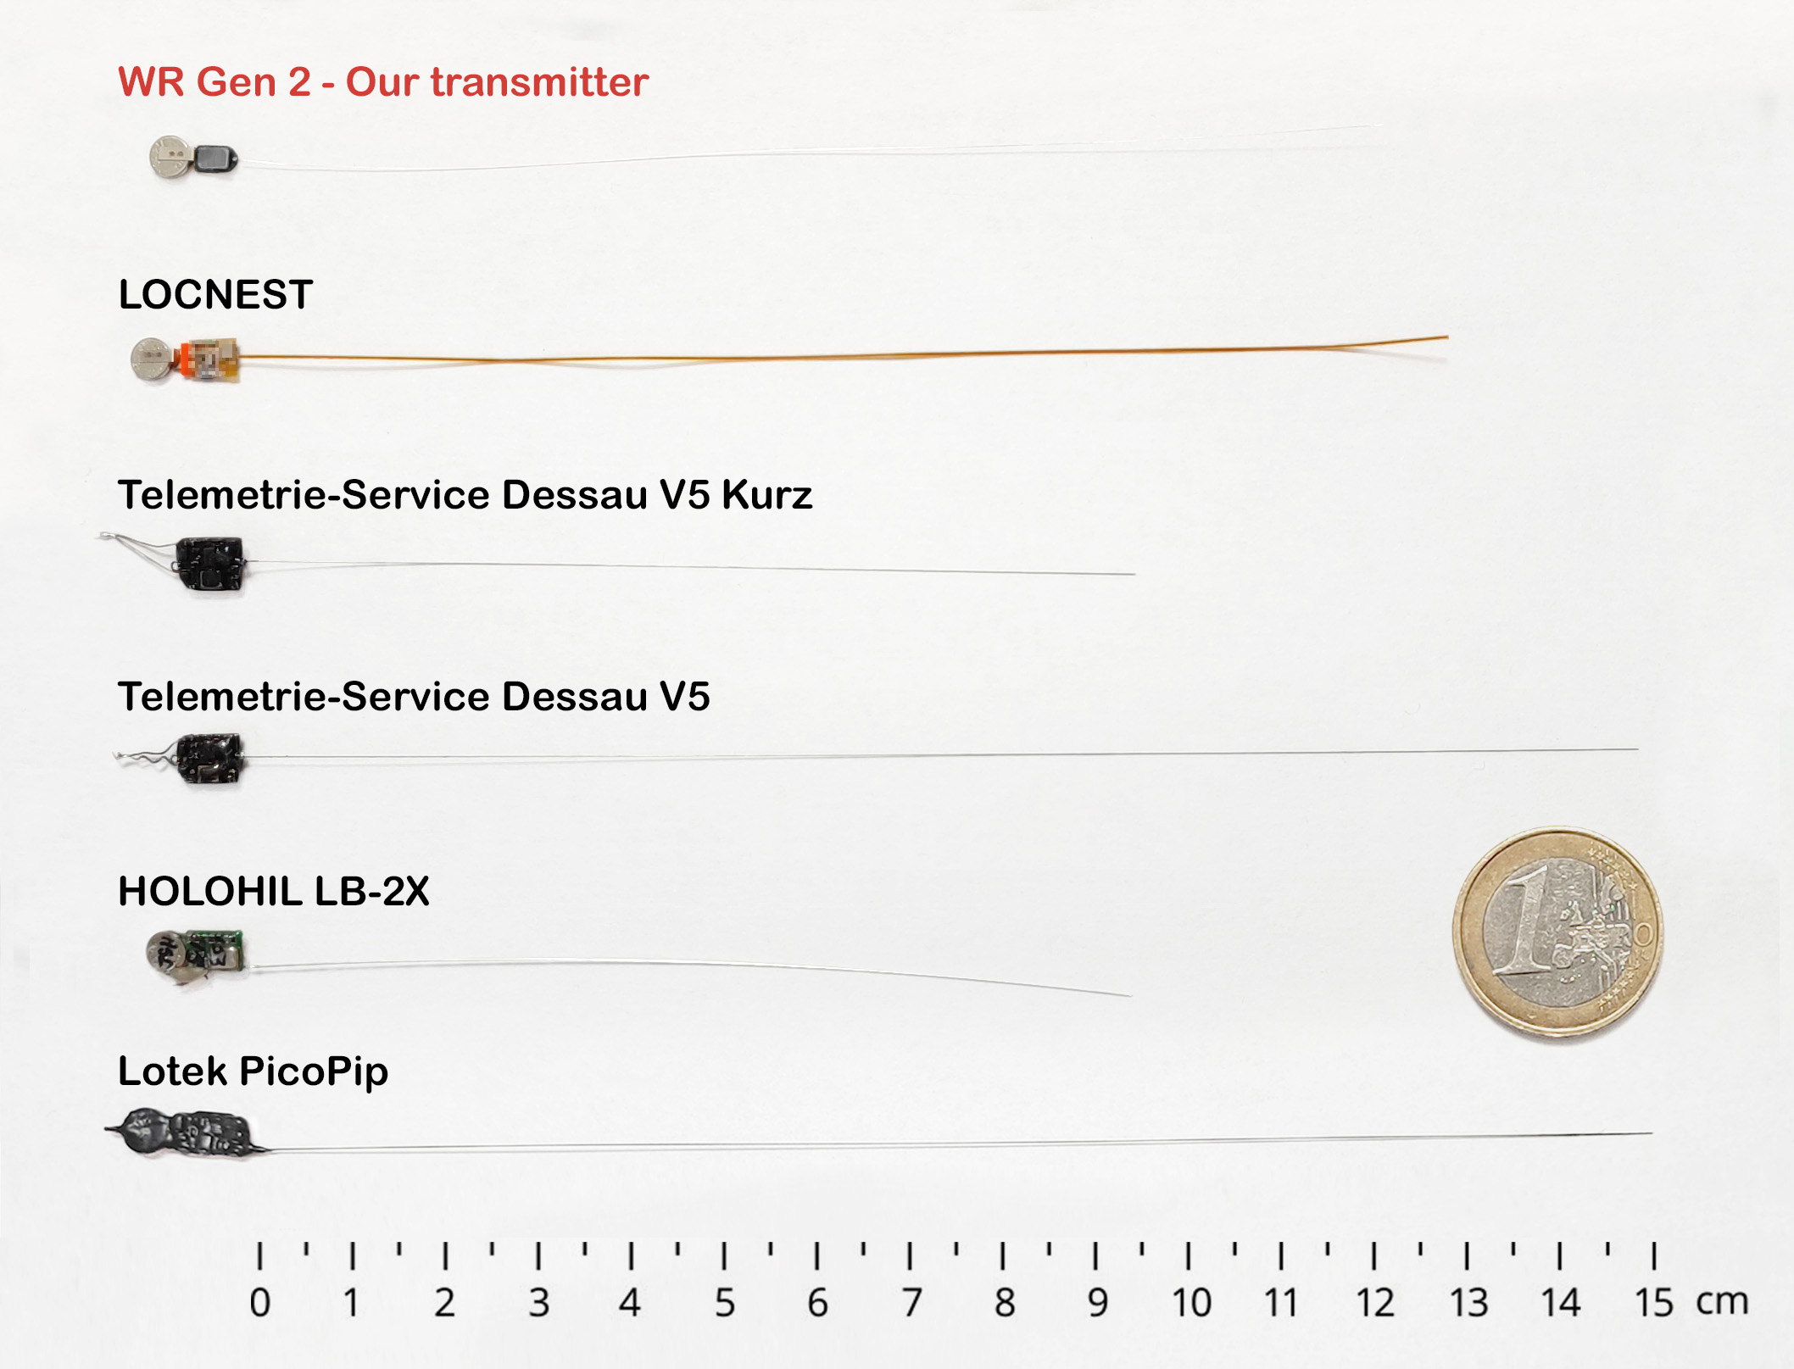
Comparison With Transmitters From Other Manunfacturers

Slide 8
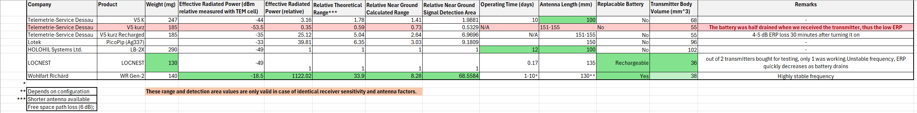

Slide 11
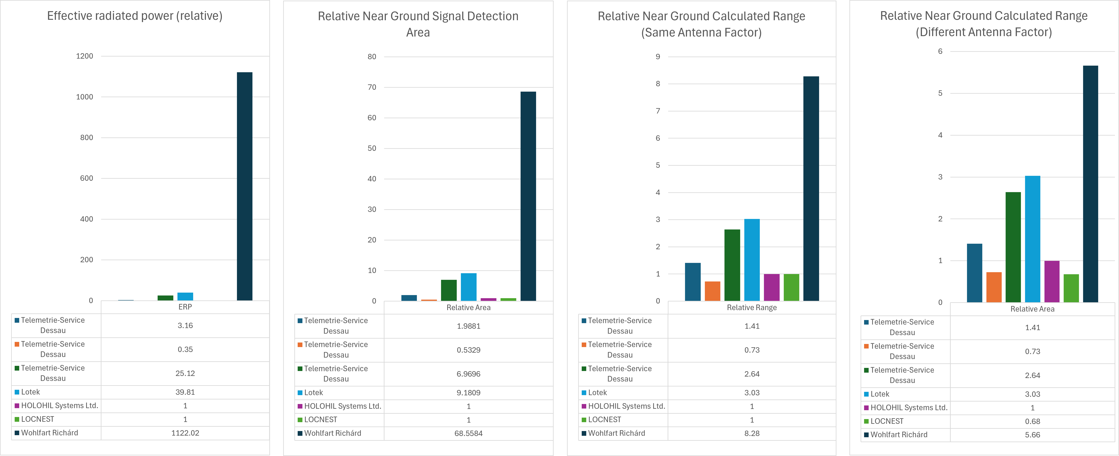

Slide 13
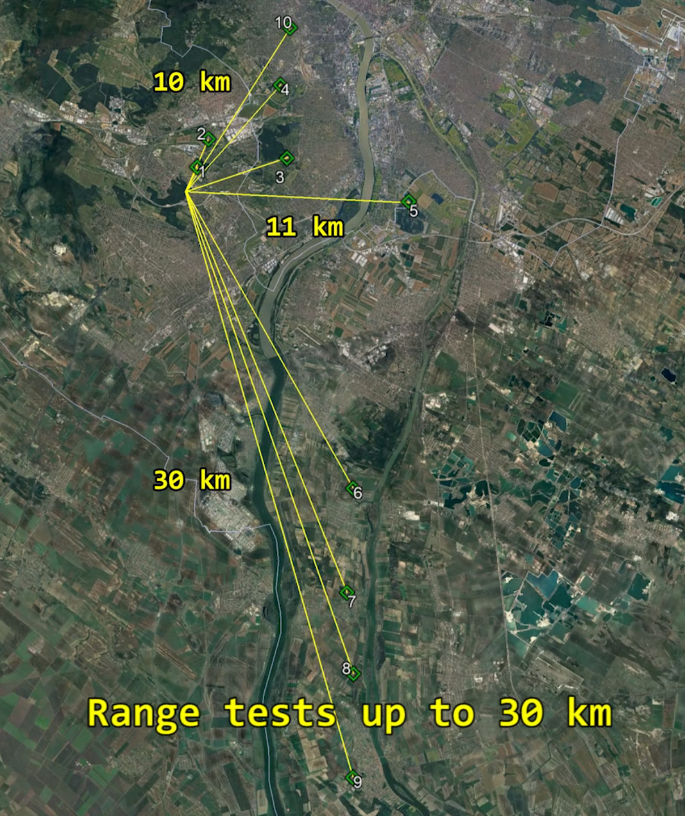
Range Test
What is the maximum range we can achieve?
We decided to test it!
(Under good conditions, direct line of sight)
info@telemetry.hu | www.telemetry.hu | Richárd Wohlfart

Slide 14
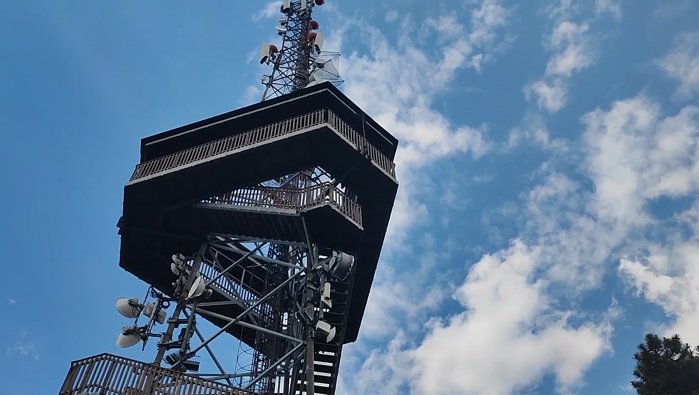
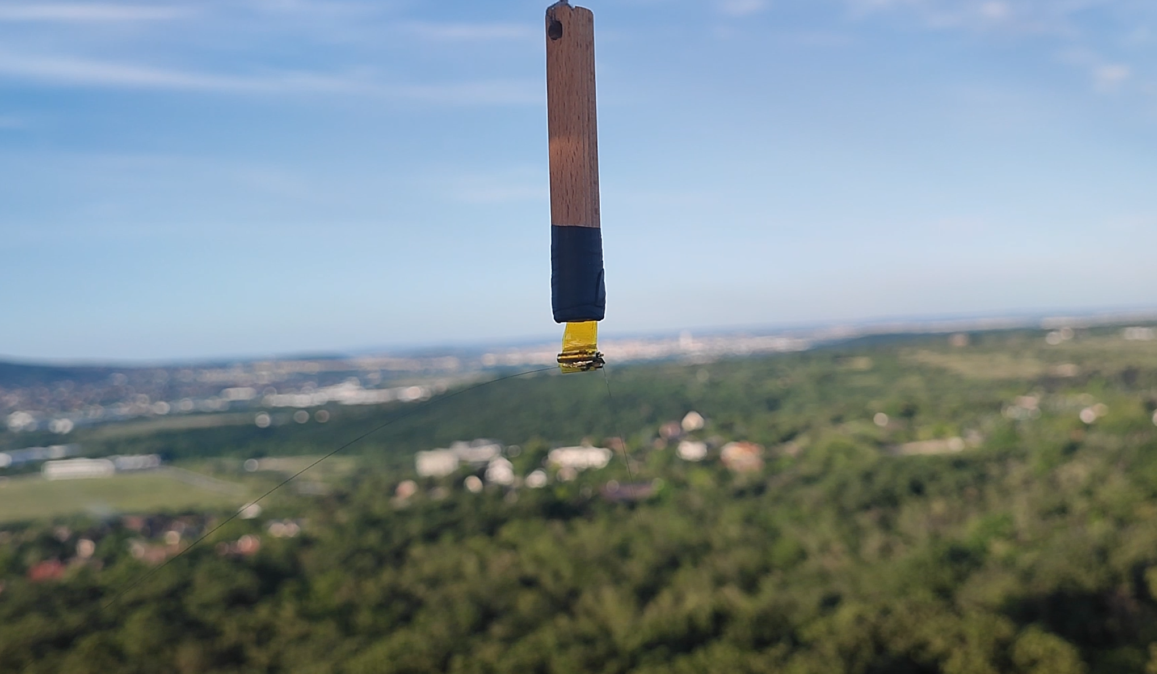
Test Preparations
Hanged the transmitter from a lookout tower (Anna-hegyi kilátó)
The transmitter was taped to a rod to reduce sway
info@telemetry.hu | www.telemetry.hu | Richárd Wohlfart

Slide 15
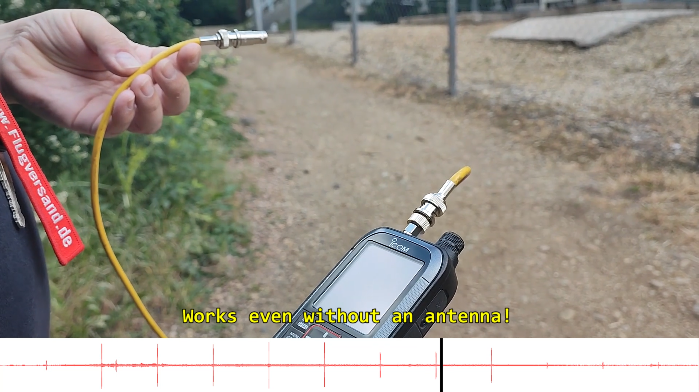
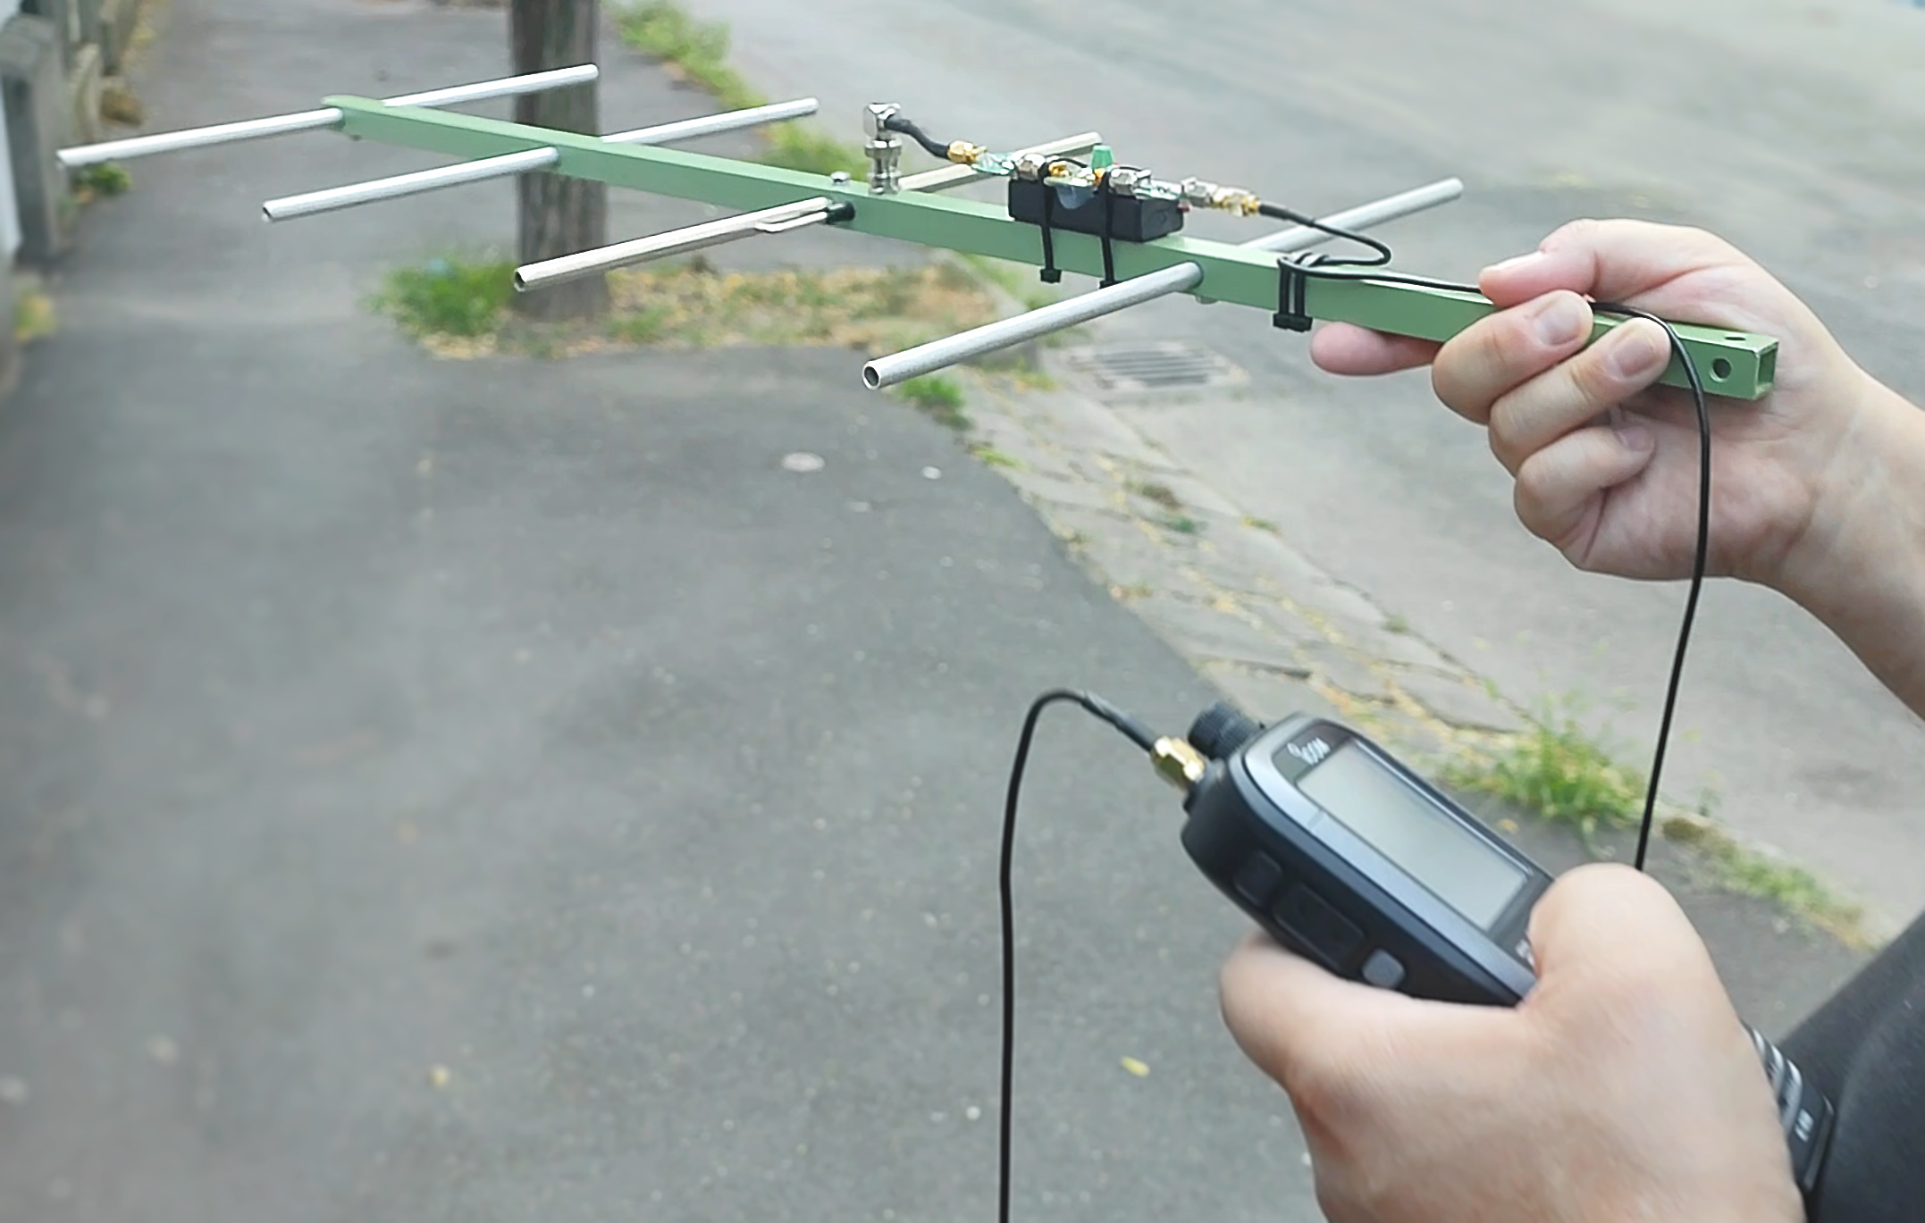
Initial tests
Under the tower, it worked even without an antenna
(Recorded signals shown below the picture, with red)
We used a radio scanner, with custom preamplifier
info@telemetry.hu | www.telemetry.hu | Richárd Wohlfart

Slide 16
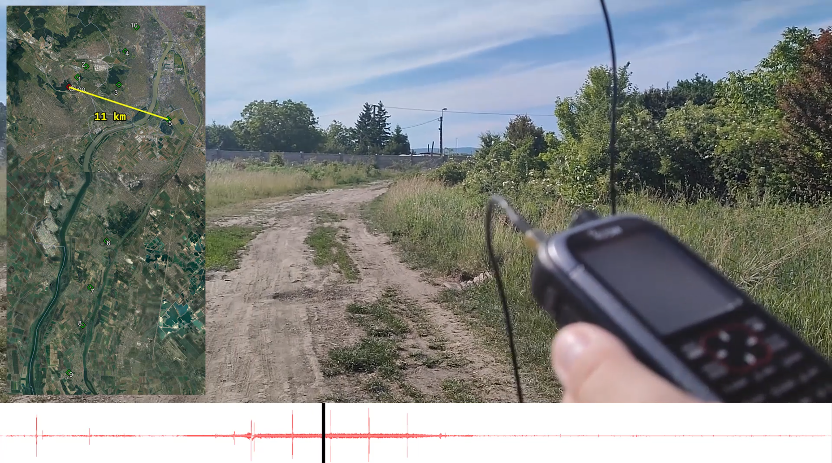
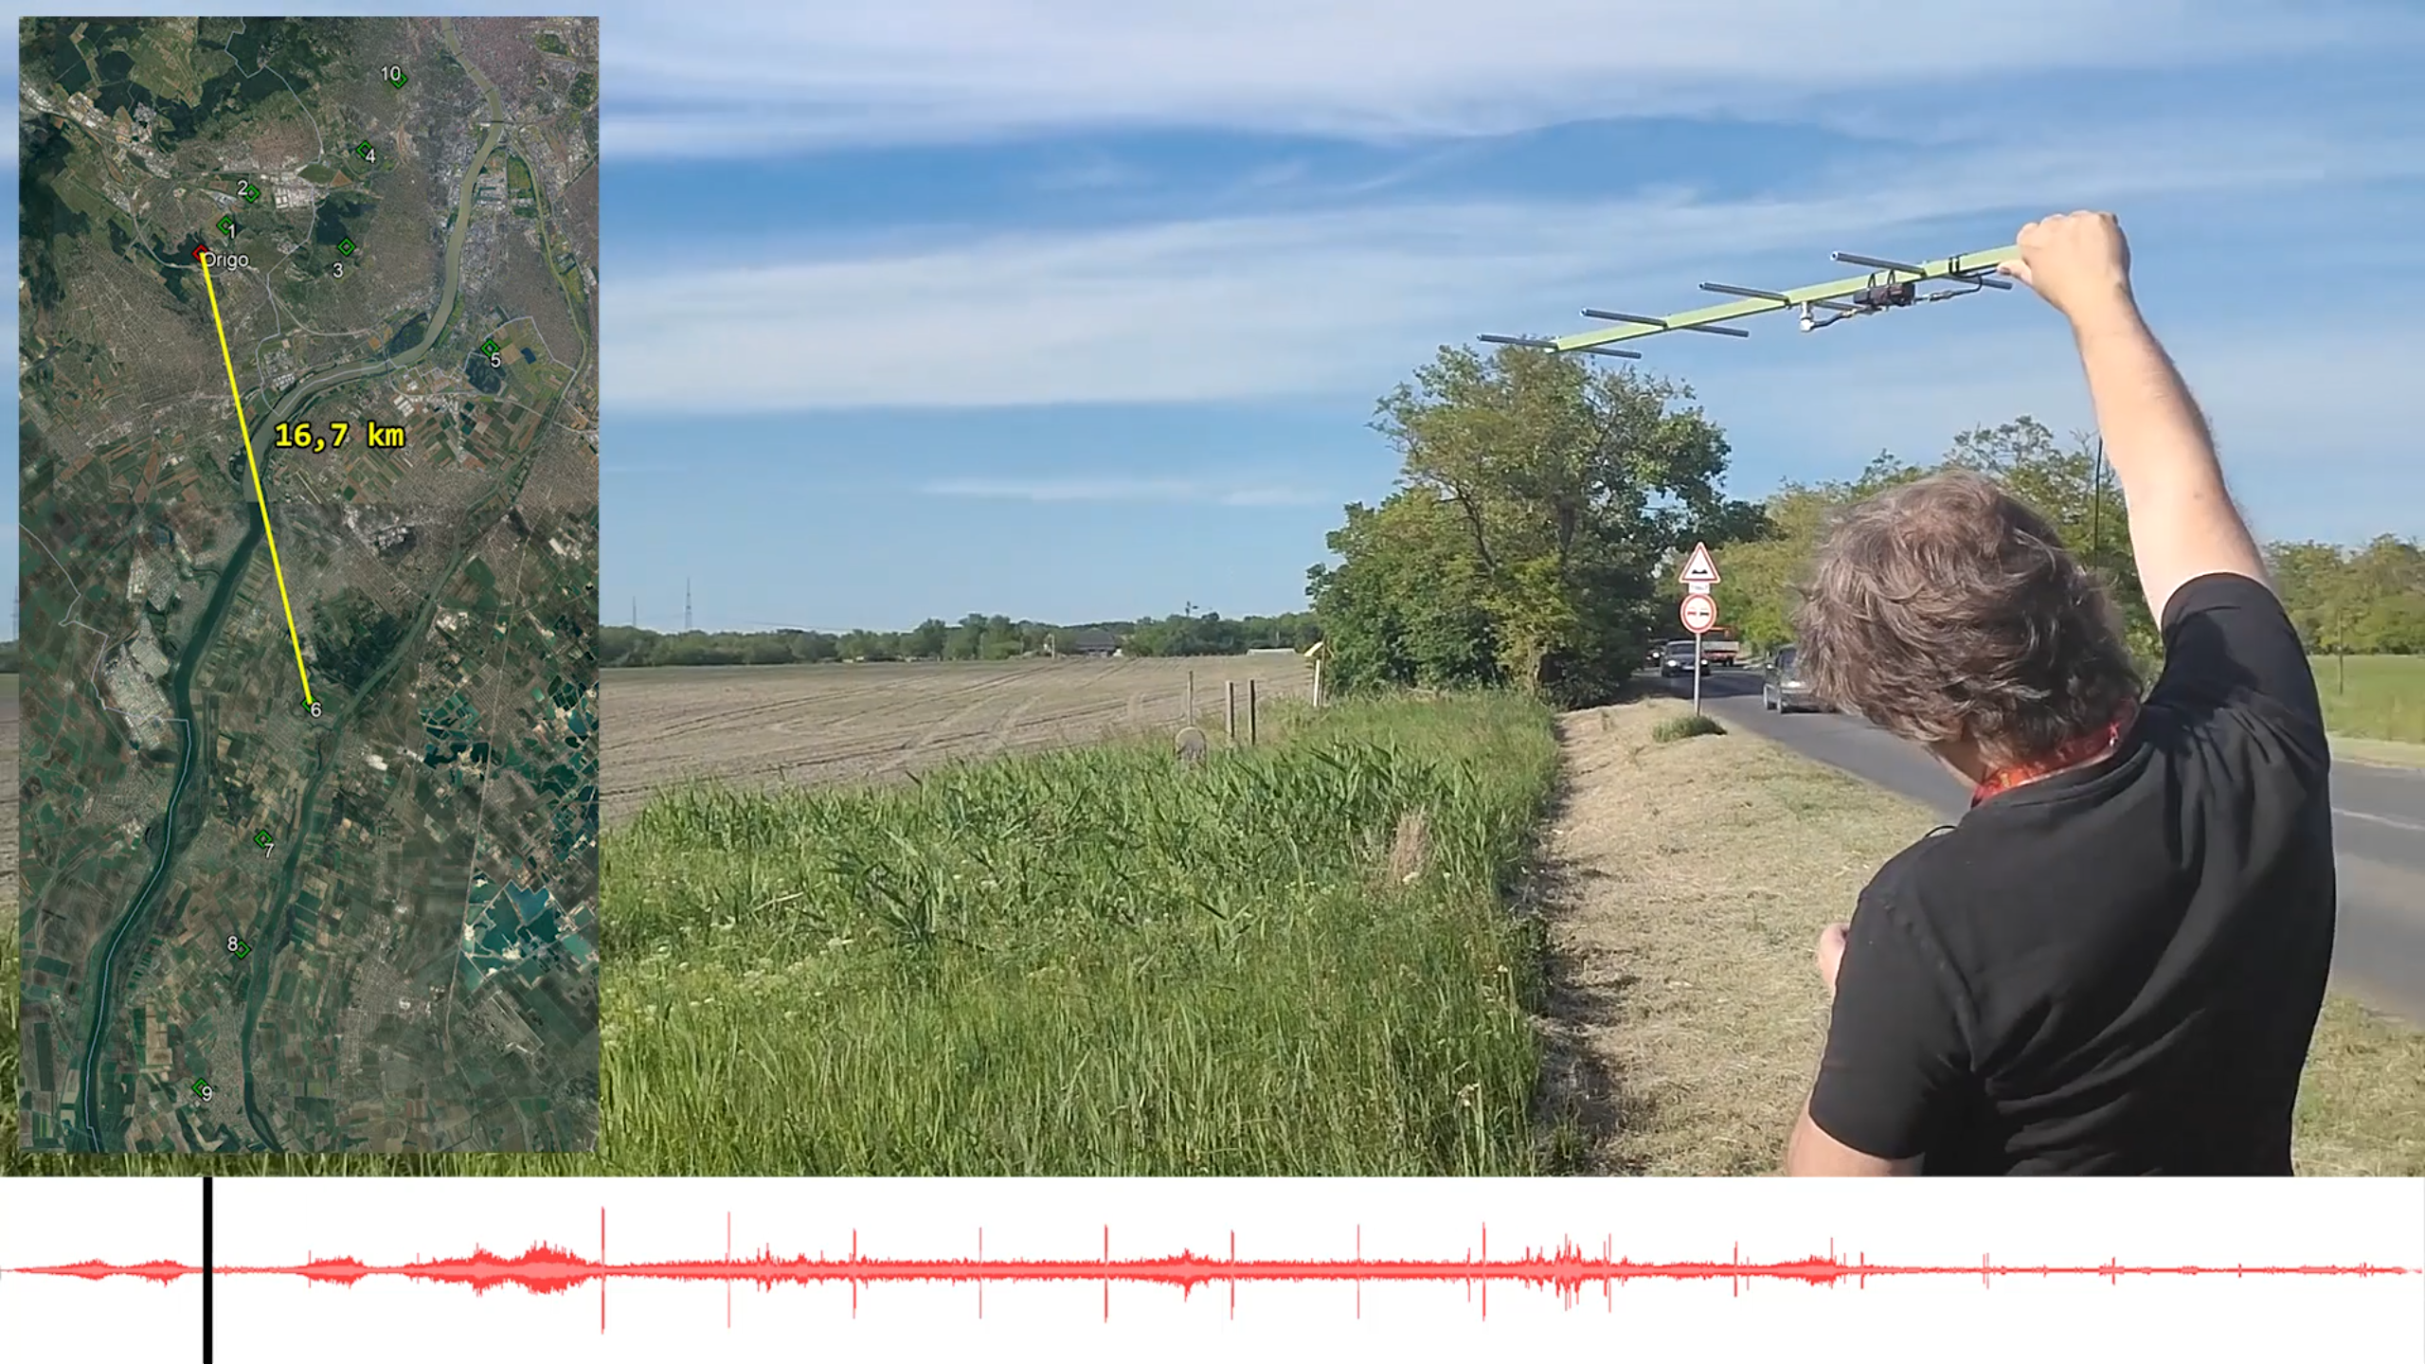
Going Further…
Started from 1 km
Quickly moved to 10 km, then 20 km…
Signal was still strong and clear
info@telemetry.hu | www.telemetry.hu | Richárd Wohlfart

Slide 17
30 km Range Test
Final test was at 30 km
Signal was getting weaker, still detectable
Could have travelled further…
info@telemetry.hu | www.telemetry.hu | Richárd Wohlfart

Slide 18
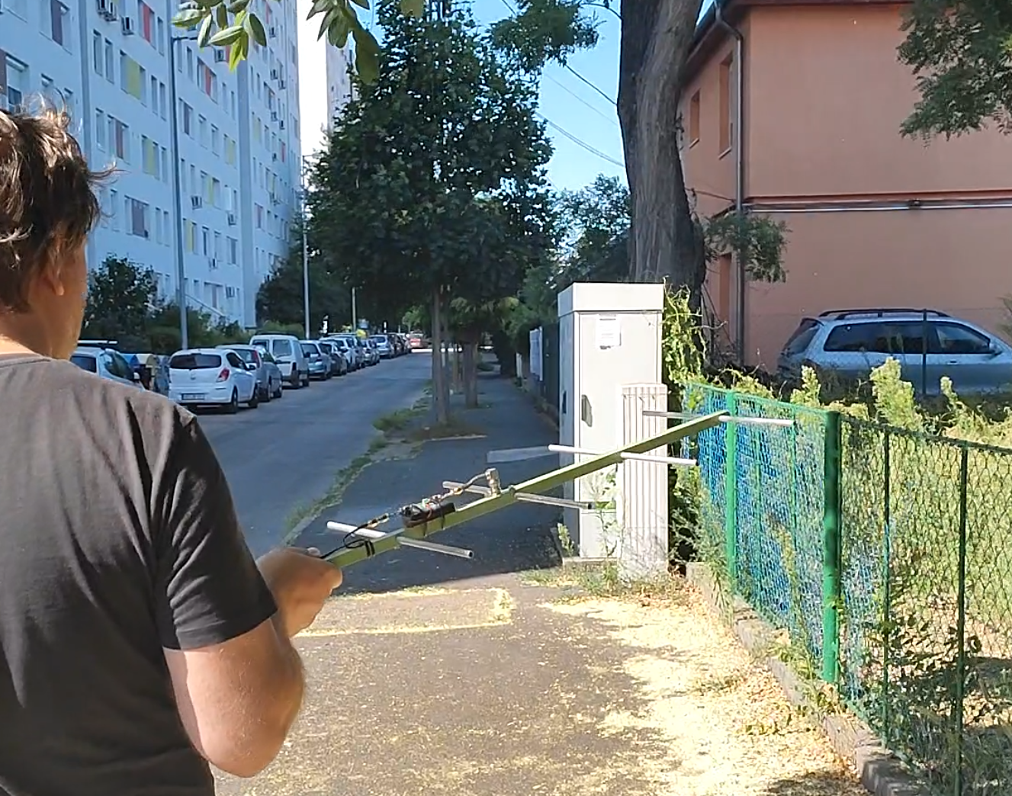
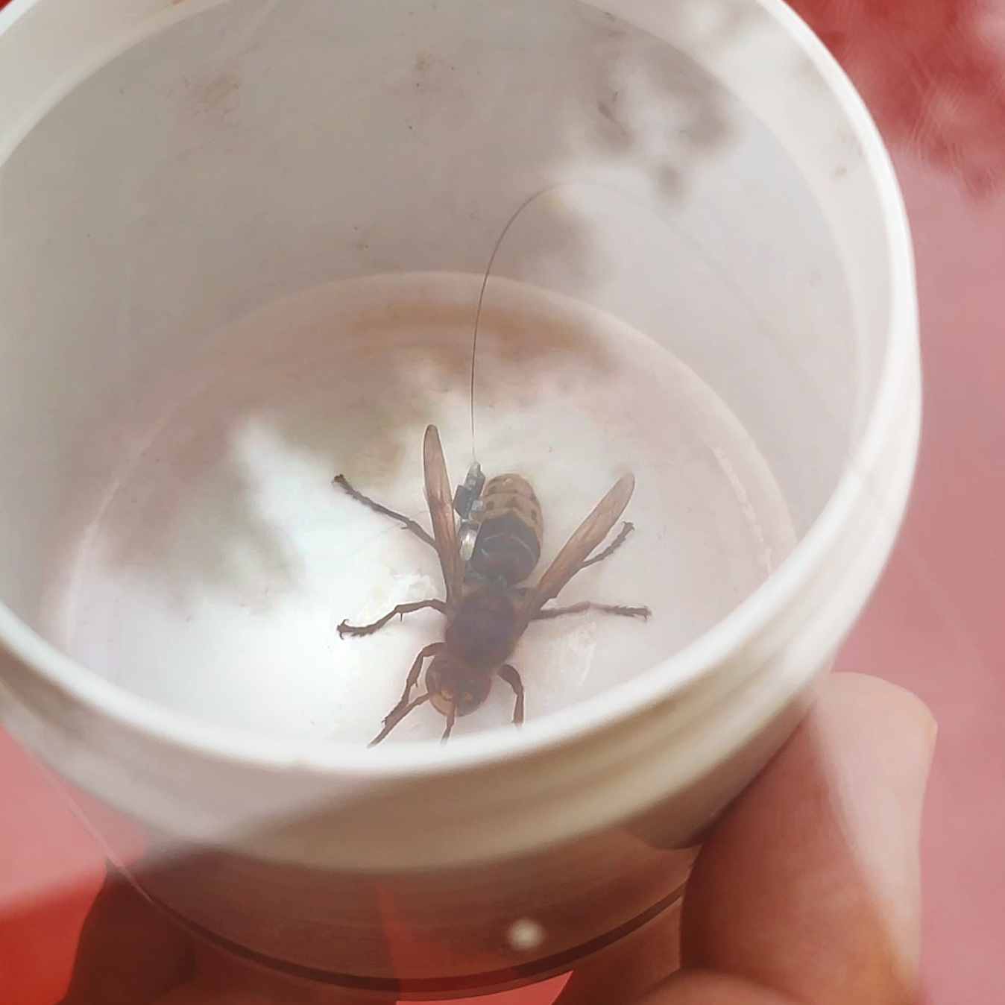
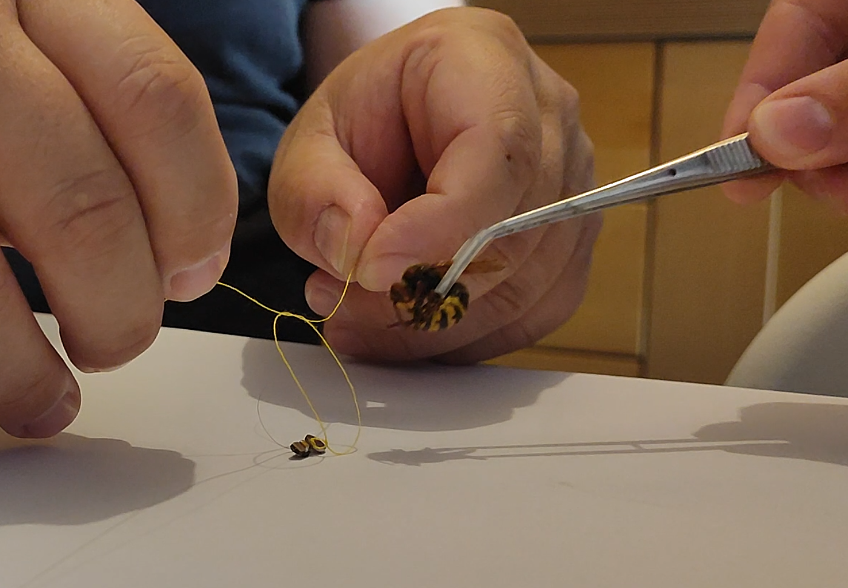
Tests with hornets
We caught and tagged hornets (Vespa Crabro)
Tested in a dense city environment
Ground level range between 200 m – 1 km, due to buildings
info@telemetry.hu | www.telemetry.hu | Richárd Wohlfart

Slide 19
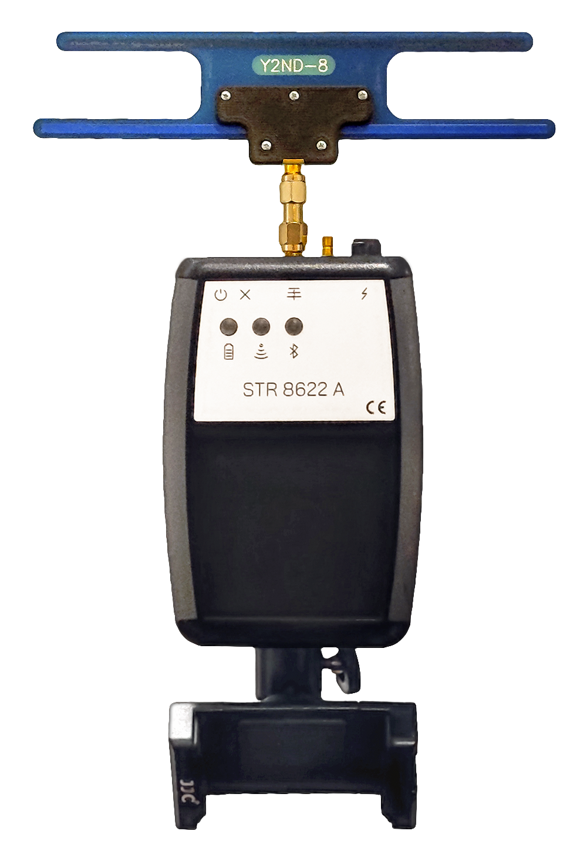
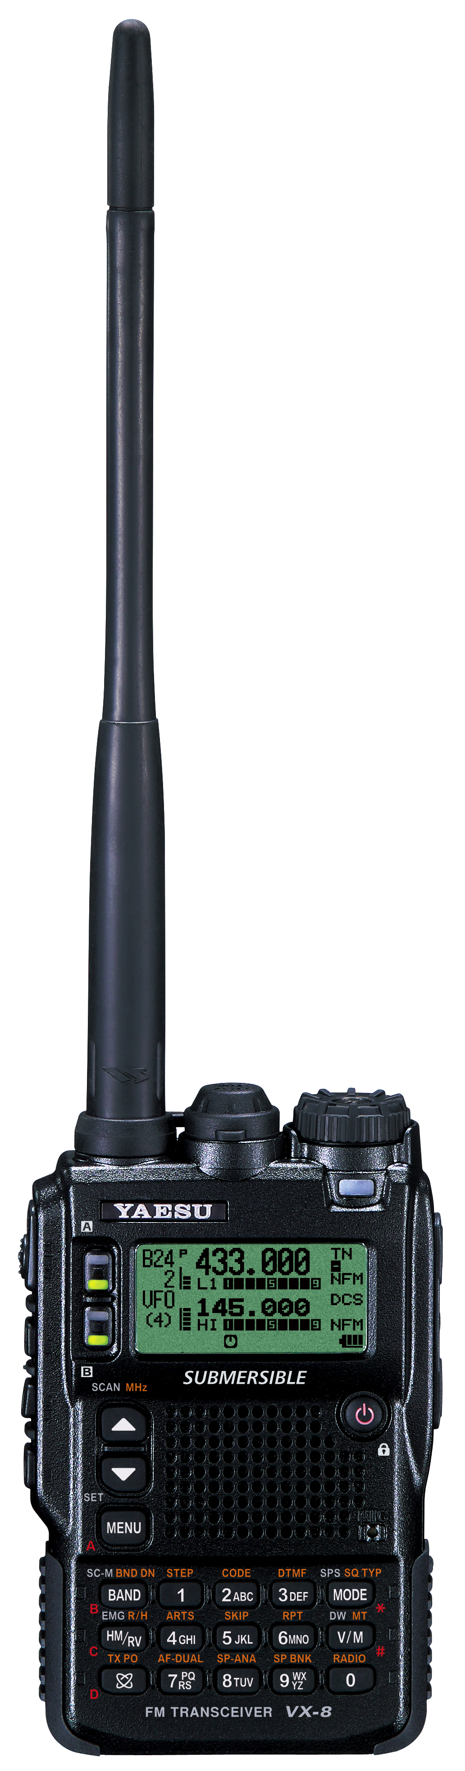
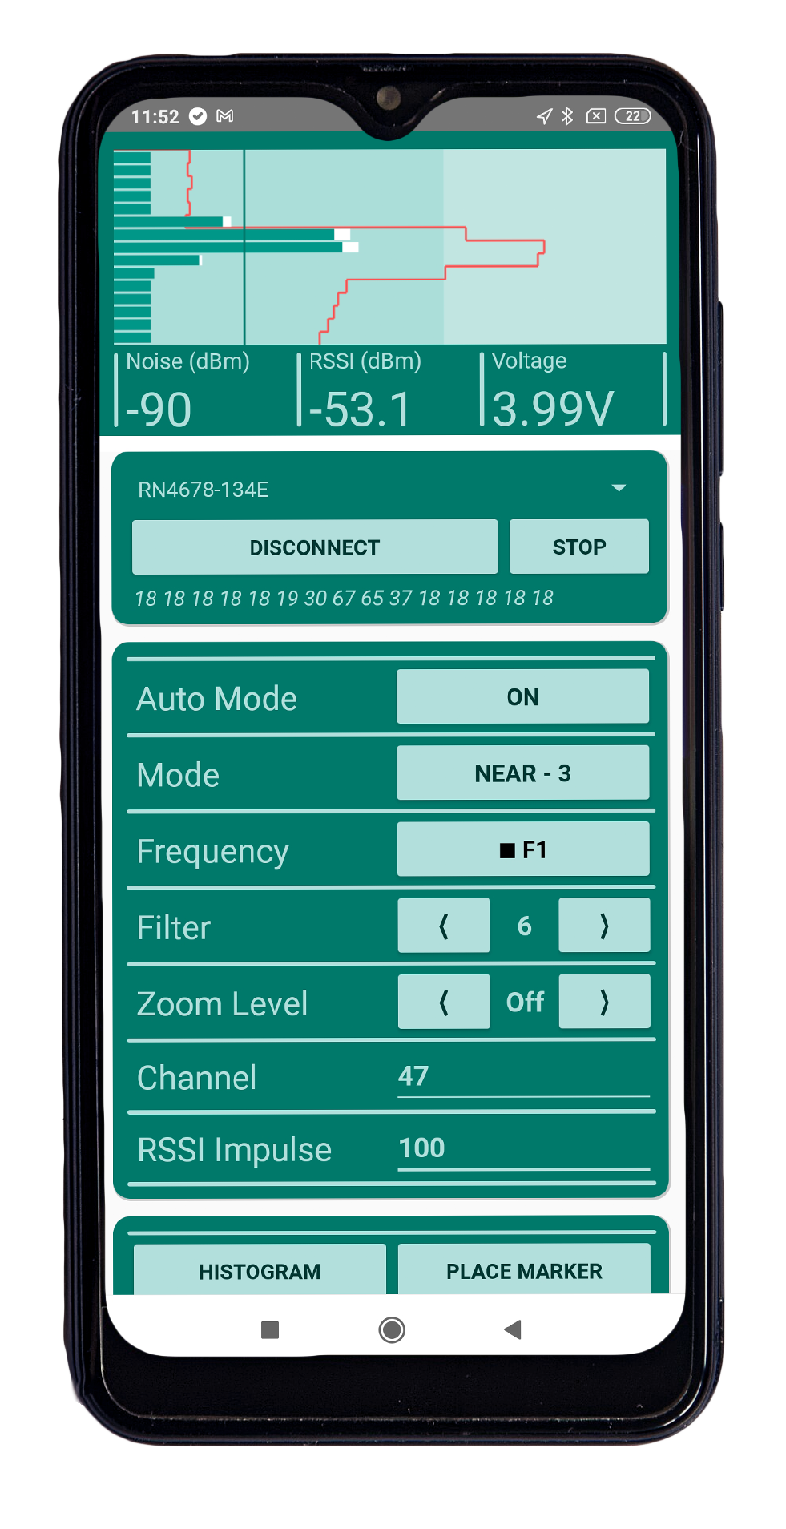
Wildlife Telemetry Receiver Vs Radio Scanners
Very low noise preamplifier – higher sensitivity, longer range
High quality preselector – reduces environmental noise
Very high frequency stability – no need for tuning
info@telemetry.hu | www.telemetry.hu | Richárd Wohlfart

Slide 20
Wildlife Telemetry Receiver Vs Radio Scanners
Short RF impulse detection – less power consumption
Accurate RSSI measurement – easy direction finding
Graphical signal display
info@telemetry.hu | www.telemetry.hu | Richárd Wohlfart

Slide 21
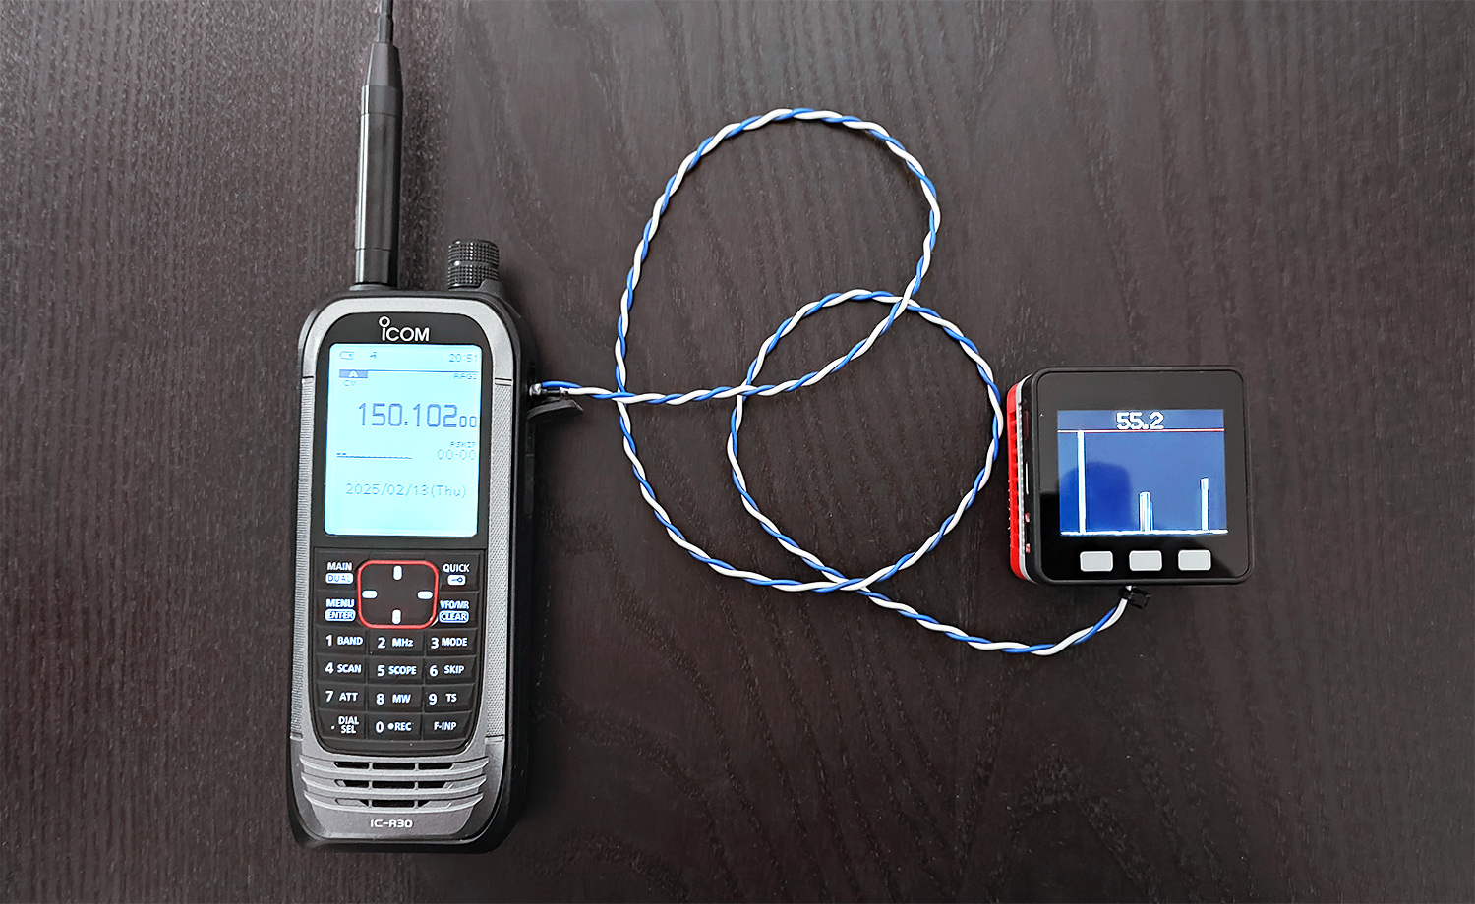
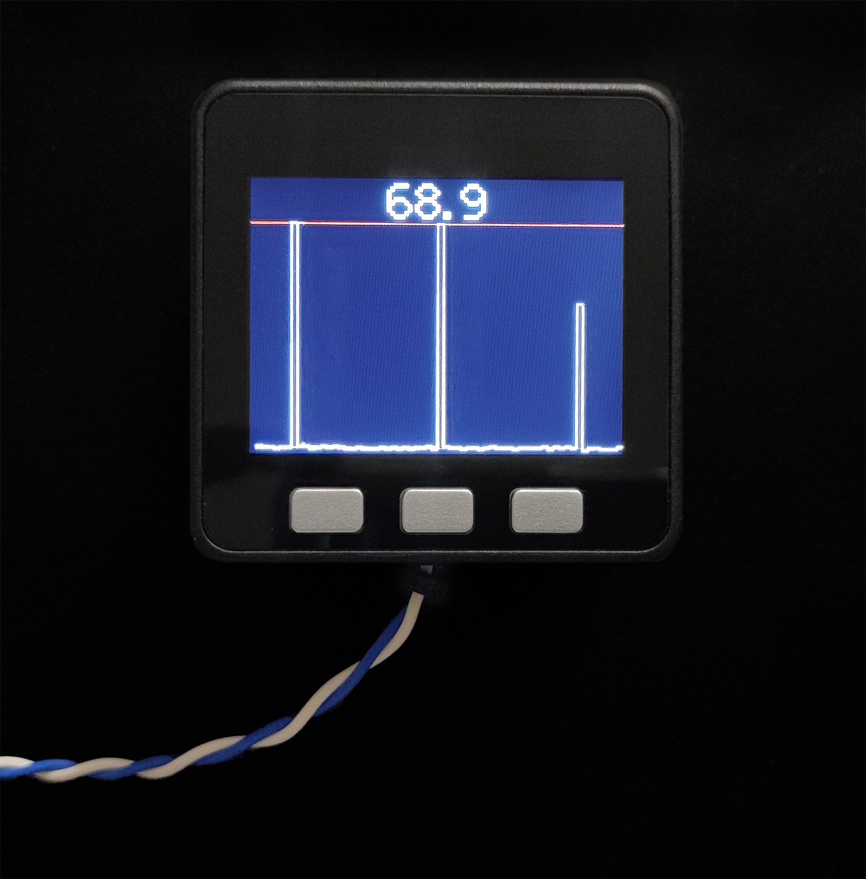
Extension for radio scanners
Prototype for an external display for radio scanners
Numeric display and Bar plot
info@telemetry.hu | www.telemetry.hu | Richárd Wohlfart

Slide 22
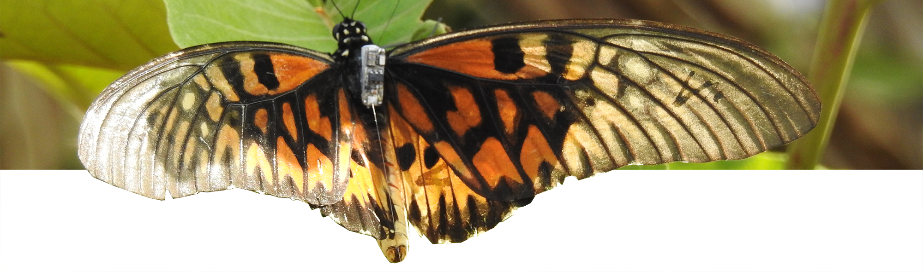
Kérdések/Questions
Elérhetőségeink/Contact:
info@telemetry.hu
www.telemetry.hu
info@telemetry.hu | www.telemetry.hu | Wohlfart Richárd

